Slide 1
Introduction to ReactJS
Dr. Basel Magableh

Slide 2
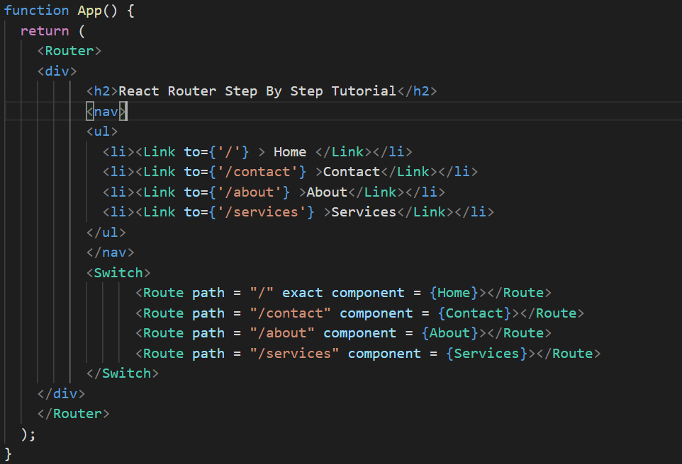
Class Agenda
What is ReactJS?
Setting up a React App
JSX Basics
Components & Props
State & Event Handling
Hooks: useState and useEffect
Local Storage Integration
Mini Project: Todo App
Q&A

Slide 3


Introduction to ReactJS
ReactJS is a powerful JavaScript library for building interactive user interfaces. Its significance in modern web development lies in its ability to create dynamic applications efficiently. This lecture will explore key features, setup, and practical applications of ReactJS.

Slide 4

What is ReactJS?
A JavaScript library for building user interfaces
Developed by Meta (Facebook)
Focuses on component-based architecture
Powers apps like Facebook, Instagram, Netflix

Slide 5

Why Use React?
Reusable components
Faster rendering with Virtual DOM
Easier state management
Huge community + ecosystem
Great for SPA (Single Page Applications)

Slide 6
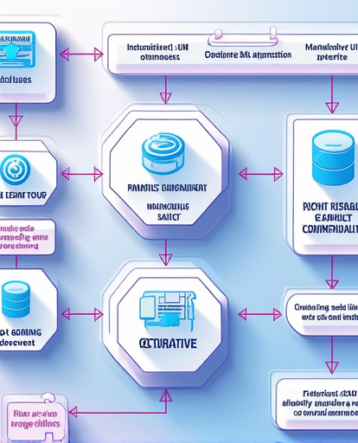
Key Features of React
React's architecture is based on reusable components, which promote modularity and maintainability in code.
Component-Based Architecture: React's architecture is based on reusable components, which promote modularity and maintainability in code.
Virtual DOM: React utilizes a virtual DOM to optimize rendering, ensuring that only changed elements are updated, which enhances performance.
Declarative UI: With React, developers can describe what the UI should look like, and React handles the rendering, making it easier to manage state and user interactions.

Slide 7
Setting Up the React Development Environment
Essential Tools and Libraries
Step-by-Step Guidance
To set up the React development environment, you need the following essential tools and libraries:
Node.js: Required to run JavaScript on the server and manage packages.
npm or Yarn: Package managers for installing React and its dependencies.
Create React App: A command-line tool to set up a new React project with a single command.
Follow these steps to set up your React development environment:
- Install Node.js from the official website.
- Open a terminal and run: npx create-react-app my-app.
- Navigate to the project directory and start the development server using: npm start.

Slide 8

What is Vite?
• A modern build tool and development server
• Created by Evan You (creator of Vue.js)
• Lightning-fast startup using native ES Modules
• Optimized for frameworks like React, Vue, Svelte
• Replaces Create React App for many developers

Slide 9
Setting Up React:
Using Create project:
This is a powerful tool that allows you to quickly set up a new React project with all the necessary configurations and dependencies. To get started, simply run the following command in your terminal:
npx create-react-app my-app
Navigate into your project directory and start the development server by executing:
npm start.
This will launch your new React application in your default web browser, allowing you to see your changes in real-time!
Using Vite.
To create the app run:
npm create vite@latest my-app --template react.
To Install dependencies run:
npm install.
To lunch your react App run:
npm run dev.

Slide 10

JSX: Creating Functional Components
Introduction to JSX
JSX (JavaScript XML) allows developers to write HTML-like syntax directly within JavaScript, making it easier to create React elements.
Practical Examples
Creating a Simple Component:
function HelloWorld() { return <h1>Hello, World!</h1>; }

Slide 11
JSX – JavaScript XML
• React components must return exactly one parent element.
• In this example, <h1> and <p> are side-by-side with no parent.
• This will throw an error:
“Adjacent JSX elements must be wrapped in an enclosing tag.”
Looks like HTML, but it’s JavaScript
Allows embedding logic in UI
Example:
const name = "React";
return Hello, {name}!;
Must return one parent element:
function MyComponent() {
return (
<h1>Hello</h1>
<p>Welcome to my app</p>
);
}

Slide 12
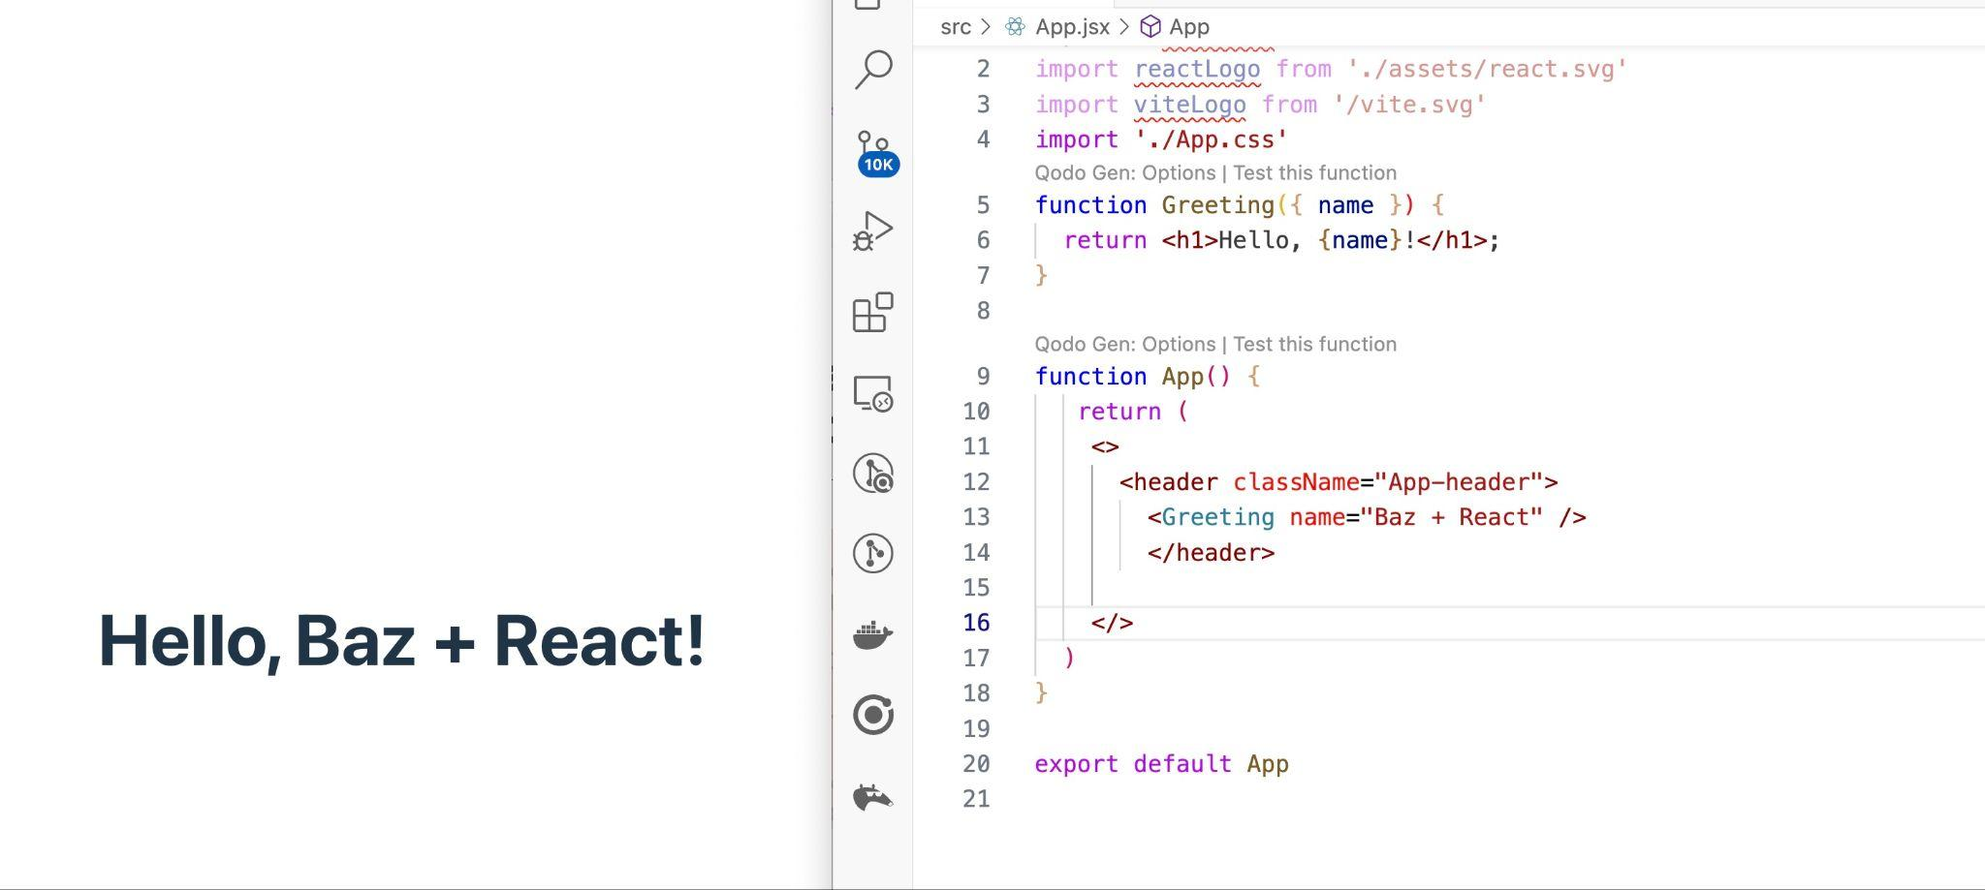
Understanding Props in React
Passing Props to Components: <ComponentName props=value/>
<Greeting name=”Stephen”/>
Destructuring Props
Destructuring can simplify prop usage:
function Greeting() { return <**h1>Hello, {name}!</h1**>; }
What are Props?
Props (short for properties) are used to pass data from one component to another, enabling dynamic rendering.

Slide 13

Props – Passing Data
Props = function inputs: In React, props serve as the primary means of passing data and event handlers from a parent component to a child component, enabling a clear flow of information and functionality.
Flow from parent to child: The unidirectional data flow in React ensures that data is passed down from parent components to child components, maintaining a predictable structure and enhancing the overall maintainability of the application.
Immutable: Props are immutable, meaning that once they are set by the parent component, they cannot be altered by the child component, which helps to prevent unintended side effects and promotes a more stable and reliable application architecture.

Slide 14
Why we destructure props in React
Destructure props in React really helps write cleaner, more readable components.
//Without destructuring:
function Greeting(props) {
return <h1>Hello, {props.name}</h1>;
}
//With destructuring:
function Greeting({ name }) {
return <h1>Hello, {name}</h1>;
}
function UserCard({ firstName, lastName, email }) {
return (
<>
<h1>{firstName} {lastName}</h1>
<p>{email}</p>
</>
);
}
Notes:
Fantastic question! 🔍 Understanding why we destructure props in React really helps write cleaner, more readable components. Let’s break it down simply 👇
✅ Why Destructure Props in React?
🔹 1. Cleaner Code
Without destructuring:
function Greeting(props) {
return <h1>Hello, {props.name}</h1>;
}
With destructuring:
function Greeting({ name }) {
return <h1>Hello, {name}</h1>;
}
✅ Looks simpler
✅ Less repetition (props.name → just name)
🔹 2. Improved Readability
It’s easier to quickly see which props the component expects.
function Profile({ username, age, avatar }) {
// You immediately know what this component uses
}
🔹 3. Avoids Repeating props.
If you’re using multiple props, destructuring avoids clutter:
Without destructuring:
<h1>{props.firstName} {props.lastName}</h1>
<p>{props.email}</p>
With destructuring:
function UserCard({ firstName, lastName, email }) {
return (
<>
<h1>{firstName} {lastName}</h1>
<p>{email}</p>
</>
);
}
🧠 Bonus: You Can Destructure in Parameters or Inside Function
Both work:
// In parameters
function Info({ name }) { ... }
// Inside the function
function Info(props) {
const { name } = props;
}
🧪 Real-Life Analogy:
Instead of saying:
“Give me the book on the desk in the blue cover in the left corner…”
You just say:
“Give me the blue book.”
Destructuring = getting just what you need 🧩
Would you like this explanation as a slide to include in your React presentation? I can format it for Canva too!

Slide 15

Components
Building blocks of a React app
Functional Components (preferred)
function Welcome()
{
return <h1>Welcome to React</h1<;
}
To add the component to your app just add:
<Welcome />
Can nest and reuse components

Slide 16
NESTING COMPONENT
function Header() {
return <h1>My App</h1>;
}
function Footer() {
return <p>© 2025</p>;
}
function App() {
return (
<div>
<Header />
<p>Welcome to my app!</p>
<Footer />
</div>
);
}

Slide 17

State in React: Creating Dynamic Interfaces
function ToggleText() {
const [isVisible, setIsVisible] = useState(true);
return ({isVisible && This text can be toggled!}<button onClick={() => setIsVisible(!isVisible)}>Toggle); }
State allows React components to manage dynamic data that influences rendering.
Introduction to State: State allows React components to manage dynamic data that influences rendering.
Example of State Management: Using the useState hook:
const [isVisible, setIsVisible] = useState(true);
Creating Dynamic Interfaces: State can be used to toggle text or manage form inputs:

Slide 18
State in React
State stores dynamic data
Use useState hook
const [count, setCount] = useState(0);
Updating state re-renders component
<div className="card">
<button onClick={() => setCount((count) => count + 1)}>
count is {count}
</button>
</div>

Slide 19
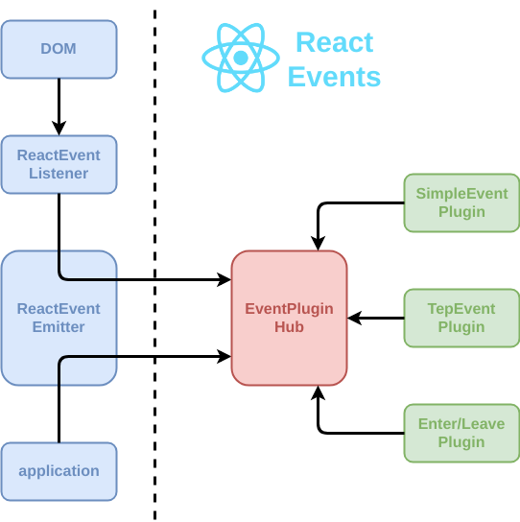
Handling User Events in React
Managing User Interactions
React provides a straightforward way to handle events like clicks and form submissions.
Example of Event Handling
Preventing Default Behavior
To prevent default actions (like form submission):
const handleSubmit = (event) => { event.preventDefault(); // Handle form submission };

Slide 20

Arrow Function
• Shorter syntax for writing functions
• Keeps the `this` context in components
• Commonly used in event handlers and inline logic
Example:
const sayHello = () => {
console.log("Hello!");
};
<button onClick={() => sayHello()}>Click Me</button>

Slide 21
Event Handling
Handle events like onClick, onChange
<button onClick={() => setCount(count + 1)}>Click
Use arrow functions to pass arguments

Slide 22

Conditional Rendering
Show different UI based on conditions
Use `if` statements, ternary operators, or `&&`
🧠 Example – Ternary:
{condition ? expression_if_true : expression_if_false}
{isLoggedIn ? <Logout /> : <Login />}
🧠 Example – AND (&&):
{isAdmin && <AdminPanel />}

Slide 23

Lists and Keys
Use `.map()` to render a list of elements in JSX
Each element needs a unique `key` prop for efficient rendering
Keys help React track changes, additions, or removals
🧠 Example:
const items = ["Apple", "Banana", "Cherry"];
<ul>
{items.map((item, index) => (
<li key={index}>{item}</li>
))}
</ul>

Slide 24

useEffect – Side Effects
Runs after the component renders
Used for side effects: API calls, timers, DOM updates
Can run once, on every render, or when dependencies change
Syntax:
useEffect(() => {
console.log("Component mounted");
}, []);

Slide 25
Storage Options in React
How to use:
// Save data
localStorage.setItem('theme', 'dark');
// Read data
const theme = localStorage.getItem('theme');
// Remove data
localStorage.removeItem('theme');
React apps can access Web Storage API:
localStorage: persists until manually cleared.
sessionStorage: persists until tab is closed.
Common Uses:
Save user preferences
Keep user logged in
Cache API responses

Slide 26
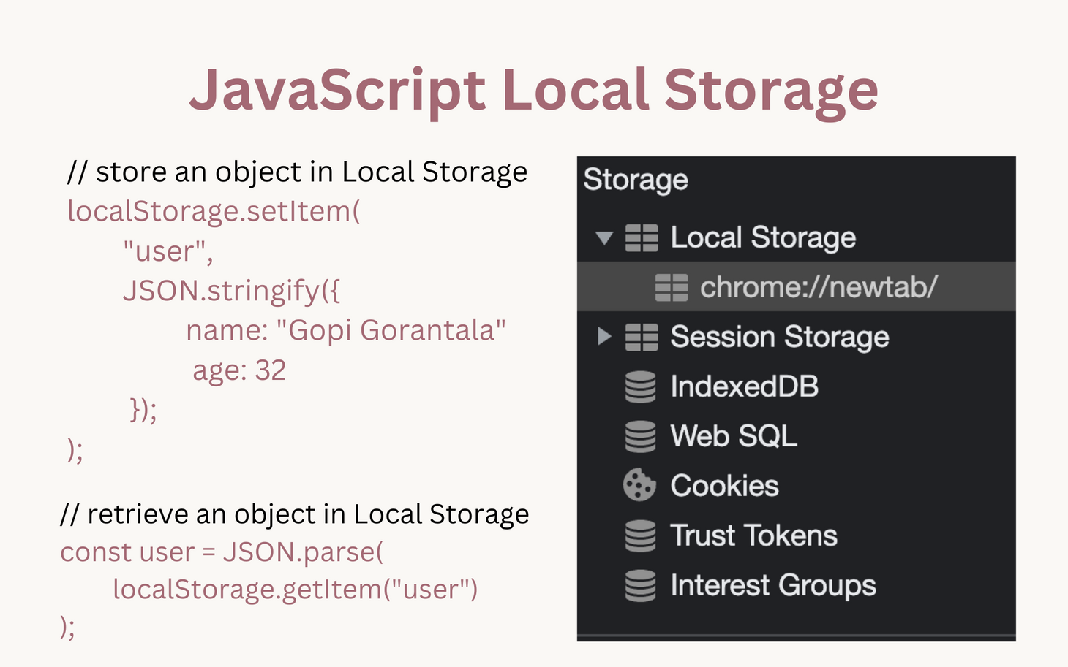
Local Storage + useEffect
- Save and retrieve data:
useEffect(() => {
localStorage.setItem("count", count);
}, [count]);
JSON.parse() and JSON.stringify() for objects

Slide 27
Storage Options React Can Access
Cookies
Accessible via document.cookie or libraries like js-cookie
Often used for authentication tokens
Can be set with expiry dates
IndexedDB
Low-level, async storage for large structured data (e.g., caching)
More complex, but great for offline apps
In-Memory State (React State, Context, Redux, etc.)
Not persistent: resets on page refresh
Used for temporary UI data and state management
Third-Party Services
Firebase, Supabase, or cloud databases
React integrates easily via APIs and hooks

Slide 28
Syncing React State with localStorage using useEffect
// 🔁 Load theme from storage on first render
useEffect(() => {
const savedTheme = localStorage.getItem('theme');
if (savedTheme) {
setTheme(savedTheme);
}
}, []);
}
// 💾 Save theme to storage when it changes
useEffect(() => {
localStorage.setItem('theme', theme);
}, [theme]);
return (
<div className={`app ${theme}`}>
<h2>Current Theme: {theme}</h2>
<button onClick={() => setTheme('light')}>Light</button>
<button onClick={() => setTheme('dark')}>Dark</button>
</div>
);
import { useState, useEffect } from 'react';
function ThemeSwitcher() {
const [theme, setTheme] = useState('light');

Slide 29
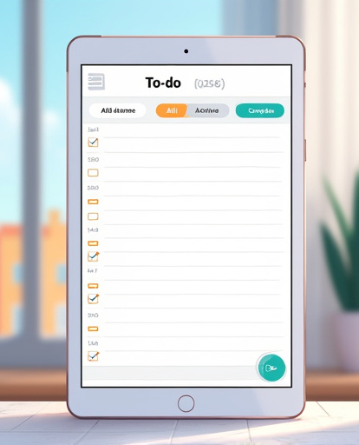
Mini Project – Todo App
Features:
Add todo item
Toggle complete
Delete item
Persist with localStorage
Bonus: Add filtering (All, Active, Completed)

Slide 30
Running and Testing the React Application
Running the Application Locally
To run the React application locally, use npm start to run the app in development mode.
Tips for Testing and Debugging
For effective testing and debugging, utilize browser developer tools for inspecting elements and debugging. Additionally, implement console logs to trace data flow and event handling.

Slide 31
Best Practices for React Development
Code Organization
Component Design
Performance Optimization
Keep components small and focused. Organize files by feature or component type.
Follow the single responsibility principle for components to enhance reusability.
Use techniques like memoization and lazy loading to improve performance.

Slide 32

Summary and Key Takeaways
This lecture covered the essential aspects of ReactJS, including its features, setup, component creation, state management, and event handling. Understanding these concepts is crucial for mastering React and building interactive web interfaces.

Slide 33
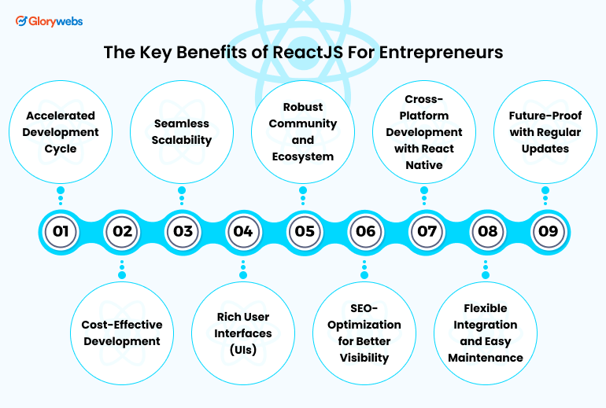
Additional Resources for Learning React
Curated List of Resources:
Documentation: React Official Documentation
Online Courses: Platforms like Udemy and Coursera offer comprehensive React courses.
Community Forums: Join forums like Stack Overflow and the Reactiflux Discord community for support.

Slide 34
What’s Next
Learn React Router
Dive into Node.js + Express
Build full-stack projects
Practice with challenges

Slide 35
Q&A

